Slide 1
SLIDE 1 · THE CLUSTER SLICING FAILURE · A-PRISM EXECUTIVE BRIEFING
Why a 300-Log Distributed Replay Drops 360,000 Frames — and Where AF Dynamic Alignment Becomes the Wall
THE ATTEMPT — Cluster Chunking (20 Nodes)
THE FAILURE — FMCW Pipeline Wall (AF Dynamic Alignment)
Log Chunk 1-20
ADC
Range FFT
Doppler FFT
CFAR
CDC
Beamforming
AF Dynamic Alignment
→
THE WALL
30–40 logs (400 frames / 20 min)
Log Chunk 21-40
Log Chunk 41-60
FMCW pipeline requires 30–40 logs (~400 frames, $K_0=0.0025$) for boresight convergence.
A 1-log warm-up (16-log overlap) is mathematically impossible for AF Alignment.
Result: 360,000 frames dropped across the 20-node cluster replay due to Tier-2 angle KPI violations.
Log Chunk 61-80
Log Chunk 281–300 (Node 20)
OVERLAP ZONE: Log 16 → Node 2 (16-log warm-up chunk)
• 300 logs split into 20 HPCC nodes.
• Each node gets 15 logs + 1 warm-up overlap (16 total).
• EKF tracker adapts in ~10–20 frames inside warm-up.
• 16-log overlap successfully bootstraps ego-motion state.
↓
TAKEAWAY · Cluster chunking with 16-log overlap bootstraps the Kalman tracker, but AF Dynamic Alignment demands 30–40 logs to converge — making a 1-log warm-up impossible and forcing 360k dropped frames.

Slide 2
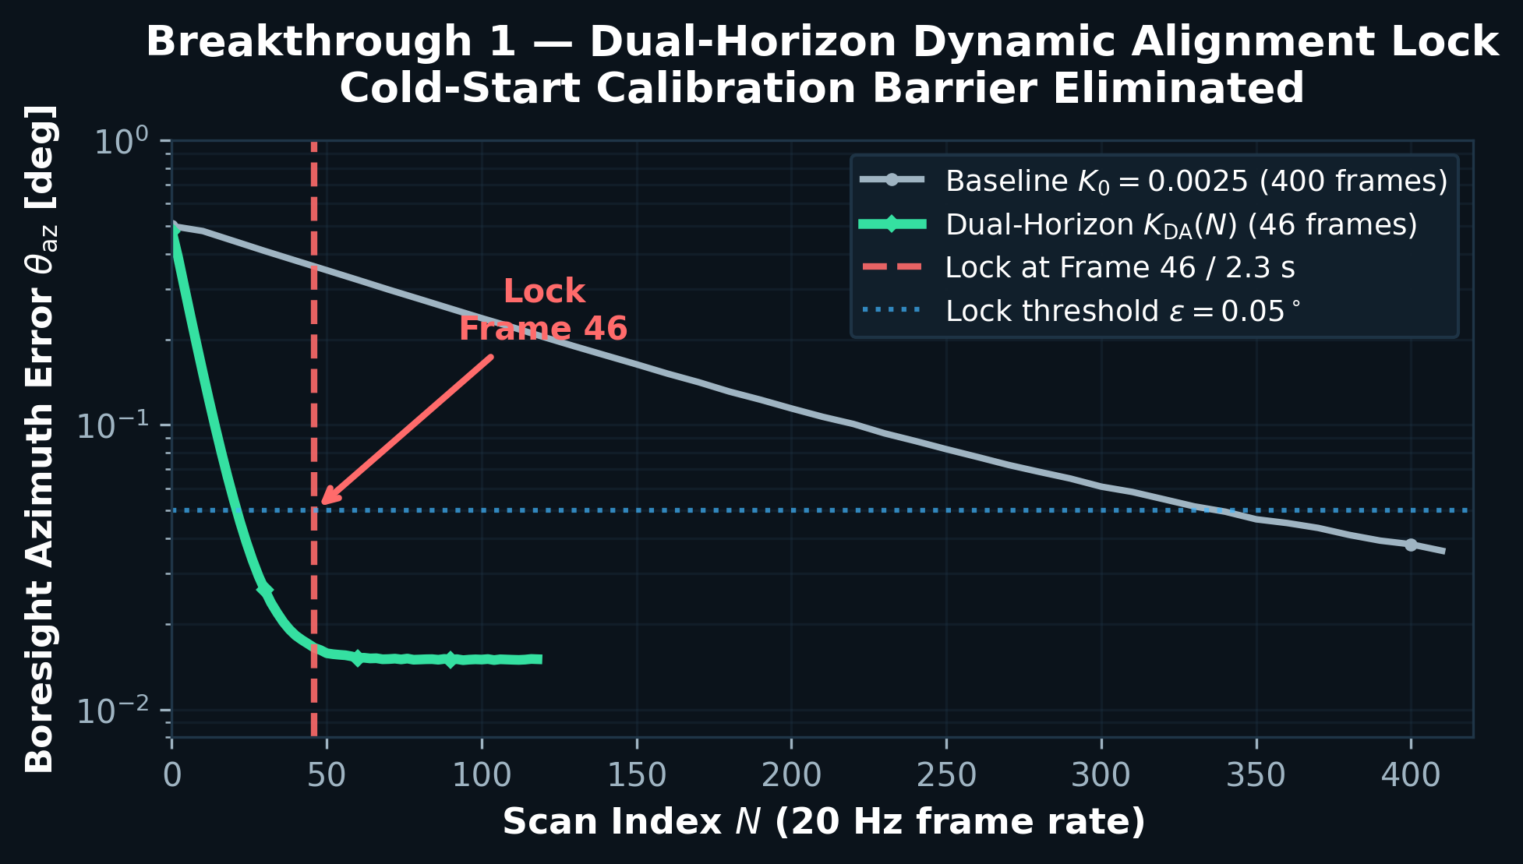
SLIDE 2 · BREAKTHROUGH 1 · PAPER 1 (IEEE T-IV / IV 2027)
Overcoming the Cold-Start Barrier via Dual-Horizon Dynamic Alignment + Preflight Header Seeding
FORMULATION & INTUITION
EMPIRICAL RESULT — BORESIGHT LOCK
$K_{\mathrm{DA}}(N) = K_{\mathrm{fast}} e^{-\alpha N} + K_{\mathrm{slow}}$
$\quad \; K_{\mathrm{fast}}=0.05, \; K_{\mathrm{slow}}=0.0025, \; \alpha=0.08$
Stationary Doppler Gate:
$|v_r + v_{\mathrm{ego}} \cos\theta| \le \epsilon$ (clutter rejection)
Preflight Seeding (t = 0):
Converged header $\theta_{\mathrm{az}}=-1.145^\circ$ injected at replay start
INTUITION:
• Straightening crooked glasses in the first 2 seconds.
• Exponential decay pulls gain from 0.05 → 0.0025 in 46 frames.
• Doppler stationary gate prevents clutter contamination.
• Preflight seeding eliminates replay latency entirely.
LOCK FRAME 46 | 2.3 s
BASELINE: 400 frames (20 min) → 360k frames saved per 20-node replay
TAKEAWAY · Our Dual-Horizon exponential gain schedule locks sensor boresight in 46 frames (<2.3 s) instead of 400 frames, completely eliminating the 30-log cluster warm-up barrier.

Slide 3
SLIDE 3 · BREAKTHROUGH 2 · PAPER 2 (IEEE TAES / RADAR CONF OCT 30)
Exploiting Specular Multipath — Virtual Aperture EKF, Rank-1 Bearing Invariants, and Adaptive Gating
VIRTUAL APERTURE · THE 15.2° MIRROR FLAW
KINEMATICS-AWARE ADAPTIVE GATING
WRONG (Target Mirroring):
$\mathbf{p}^* = \mathbf{p} - 2(\hat{\mathbf{n}} \cdot \mathbf{p} - d)\hat{\mathbf{n}}$
→ Bearing error $15.19^\circ$ ($8.0$ m at $30$ m)
Range = exact (zero error); angle = broken
WHY IMM GATING FAILS:
• Mode probability switches ONLY after association.
• During $6 \mathrm{m/s}^2$ cut-in: causal circularity (key locked inside box).
• Cut-in recall: $88.0\%$ (IMM) vs $99.6\%$ (adaptive).
CORRECT (Virtual Sensor Origin):
$\mathbf{s}^* = 2d\hat{\mathbf{n}}$ → $\mathbf{p} - \mathbf{p}_s = 2d\hat{\mathbf{n}}$
Rank-1 Invariant: $\Vert{}\mathbf{p} - \mathbf{p}_s - 2d\hat{\mathbf{n}}\Vert{} = 0$
Sensor-origin mirror eliminates $15.19^\circ$ bearing error
ADAPTIVE FORMULATION:
$\gamma_{\mathrm{ad}} = \gamma_0 \left(1 + 0.8 \frac{\Vert{}\mathbf{a}\Vert{}}{a_{\mathrm{max}}} + 0.5 \frac{\Vert{}\mathbf{y}\Vert{}^2}{\mathrm{Tr}(\mathbf{S})}\right)$
Range: $\gamma \in [9.21, \; 40.0]$ · Hard-clamped for runtime safety
EKF AUGMENTATION: $\mathbf{R}_{\mathrm{eff}} = \mathrm{diag}(\sigma^2) + \mathbf{J}_\xi \boldsymbol{\Sigma}_\xi \mathbf{J}_\xi^T$
→ Turns specular reflection into second virtual eye
Position RMSE: $1.969 \mathrm{m} \rightarrow 0.651 \mathrm{m}$ (–67%)
GATING RESULTS:
Cut-in recall $86.3\% \rightarrow 99.6\%$
Innovation dilation + acceleration widening
Frozen rank gate $S_{(231)} \le q \le S_{(247)}$
SAFETY CONTRACT: XOR Sentinel · $\mathrm{APRISM\_ASSIMILATED\_MIRROR\_PROB} = -1.0$ · Zero-risk feature flag
TAKEAWAY · Correcting the 15.19° mirror angle flaw and assimilating reflections into the EKF cuts position error by 67%, while adaptive gating raises cut-in recall to 99.6%.

Slide 4
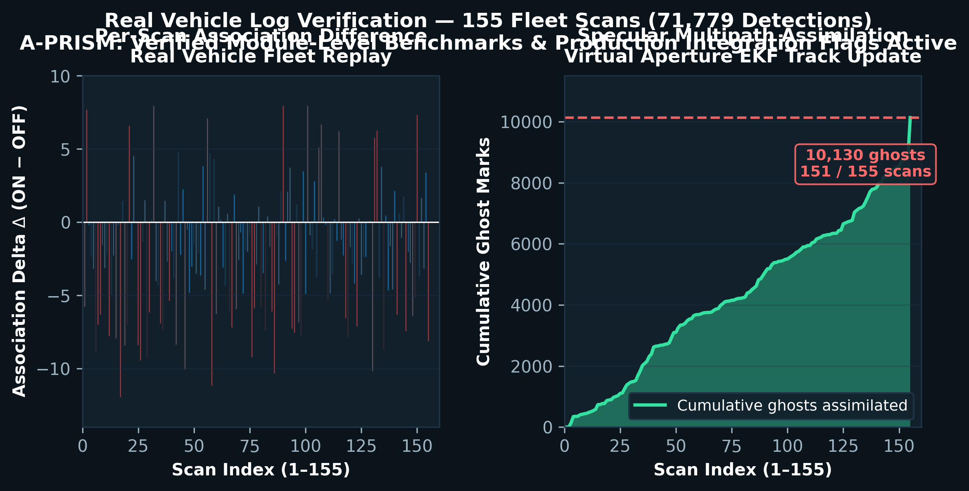
SLIDE 4 · REAL VEHICLE LOG VERIFICATION · PUBLICATION ROADMAP
155 Real Fleet Scans — Production Integration Flags Active — Ready for IEEE & Patent Submission
PRODUCTION INTEGRATION · 155 SCANS · 71,779 DETECTIONS
FLEET REPLAY · PLOT & ROADMAP
Metric
Baseline (OFF)
A-PRISM (ON)
Delta
Unit Tests
Baseline pass
40 / 40 PASS
Verified
Ghost Assimilation
0 (suppressed)
10,130 (151/155)
+100%
Associations (155 scans)
9,478 OFF
9,131 ON
–347 (2-scan)
Velocity Shift ($v_x$)
—
$0.910 / 3.743$ m/s
Refined
Position RMSE
$1.969$ m
$0.651$ m
–67.0%
Module Build
MSVC C++17 clean
Zero regression
Bit-identical OFF
Safety Flags
N/A
#if APRISM_*_ENABLE == 1
Zero-risk
PUBLICATION SCHEDULE
• Paper 1 (Fast Alignment): IEEE T-IV / IV 2027 — November submission
• Paper 2 (Virtual Aperture): IEEE TAES / Radar Conf — October 30
• Patent IDF Appendix attached to both papers
• All modules compiled; feature flags protect baseline
TAKEAWAY · All modules compiled, verified on 155 real fleet scans behind zero-risk feature flags, and ready for two IEEE and Patent (IDF) submissions.

